Slide 1
DR SNSRCAS, CBE Human Centered Design Thinking Fundamentals 21PCA204 I MCA ODD SEM UNIT 1 Defining your vision.

Slide 2
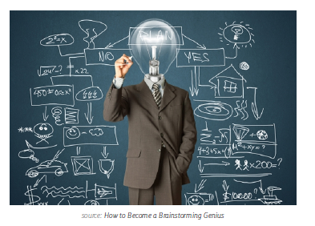
Defining your vision.
In today’s world, products aren’t just the items you can hold in your hand at the
local Best Buy. Health insurance, dating apps, and even the Internet itself can all be
considered products because they all make people’s lives easier.

Slide 3
Defining your vision.
Creating a tangible or intangible product out of thin air requires a structured
process. As you move through the Product Definition phase, you might even find
that the power of defining your product comes from what you include as well as
what you exclude. When you think about all the ideas that are bounced around,
you realize that you might get more value from understanding what your product
shouldn’t be. Do your ideas line up with the direction of the company? Have you considered
”second-best” options which might achieve 90% of the impact but with less time
and money? Kickoff meetings, business canvases, and concept sketching can all
help answer these questions. This process of elimination can help you from being
blindsided later due to over-ambition or poor judgment early on, especially as you
start gauging how the market and customers might react to your product idea.

Slide 4
THANK YOU

